Slide 1
Specialdocs eSignature
Installation Instructions

Slide 2
Table of Contents
Step 1: Configure Your Signature................................................................................ 3
Step 2: Installing Your Signature.................................................................................. 6
Installing on Microsoft Office 365................................................................................. 8
Installing on Microsoft Outlook................................................................................... 13
Installing on Mac Mail…............................................................................................. 26
Installing on iOS Mail….............................................................................................. 30
Installing on Gmail...................................................................................................... 37
Installing on Android Mail Apps ................................................................................. 42

Slide 3
Step 1: Configure Your Signature

Slide 4
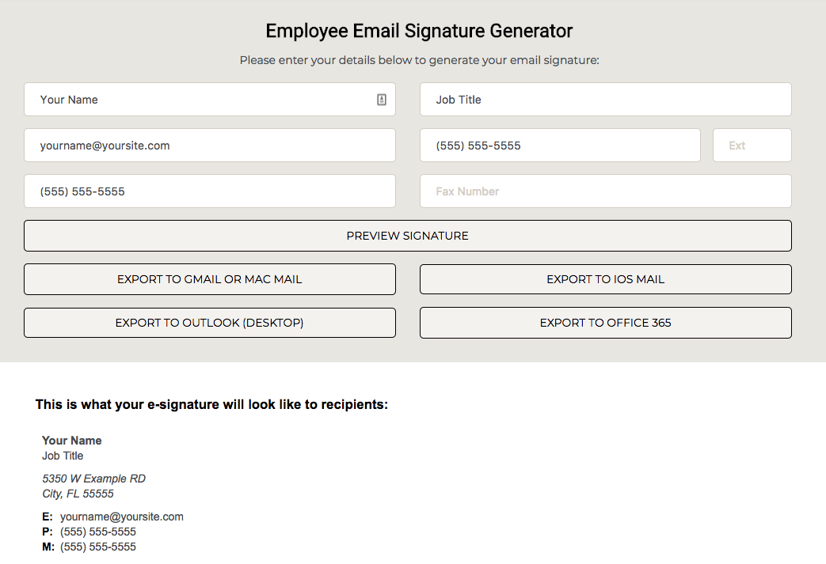
Email Signature Generator
We created an online tool to make it easy for you to generate, preview, and install your employee signature, with only a few steps!
Please visit our Signature Generator Tool here to get started:
https://specialdocs.com//email/signature/

Slide 5
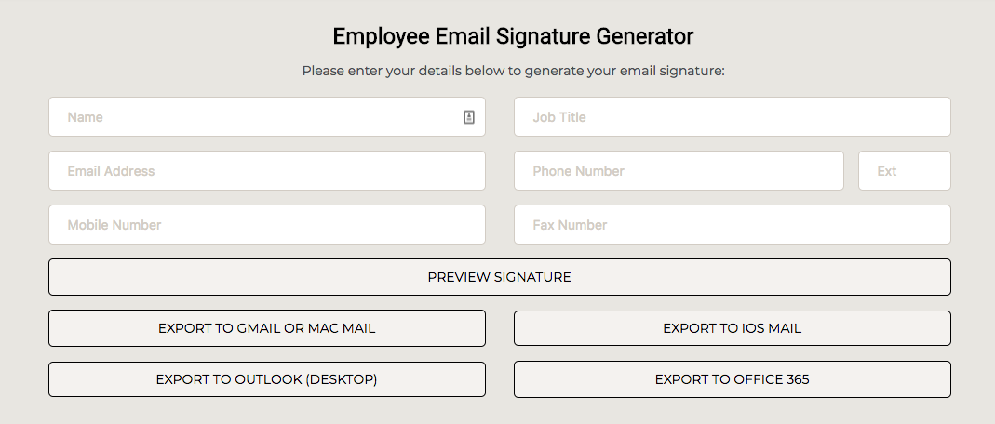
Email Signature Generator
1
2
3
4
5
Enter your name, job title, email address, and phone number.
Note: The fields with a Red dot in the image above are optional.
Then, click “Preview Signature” to preview your signature and make sure everything was entered correctly.

Slide 6
Step 2: Installing Your Signature

Slide 7






Installing Your Signature: Overview
After generating your signature, use our Signature Generator Tool to export to the email client which you are currently using:
Microsoft Office 365 (online):
Microsoft Outlook (desktop; versions 2010, 2013, and 2016):
Mac Mail (desktop):
iOS Mail (mobile):
Android Mail Apps (mobile):
Gmail (desktop):
Please refer to the following pages for instructions on how to install on your email client.
Note: If you are using a mobile device, you need to open the Signature Generator Tool on that device in a web browser (Safari, Google Chrome, etc.) Detailed instructions on how to do this will be described in the following pages.

Slide 8
Installing on Microsoft Office 365

Slide 9
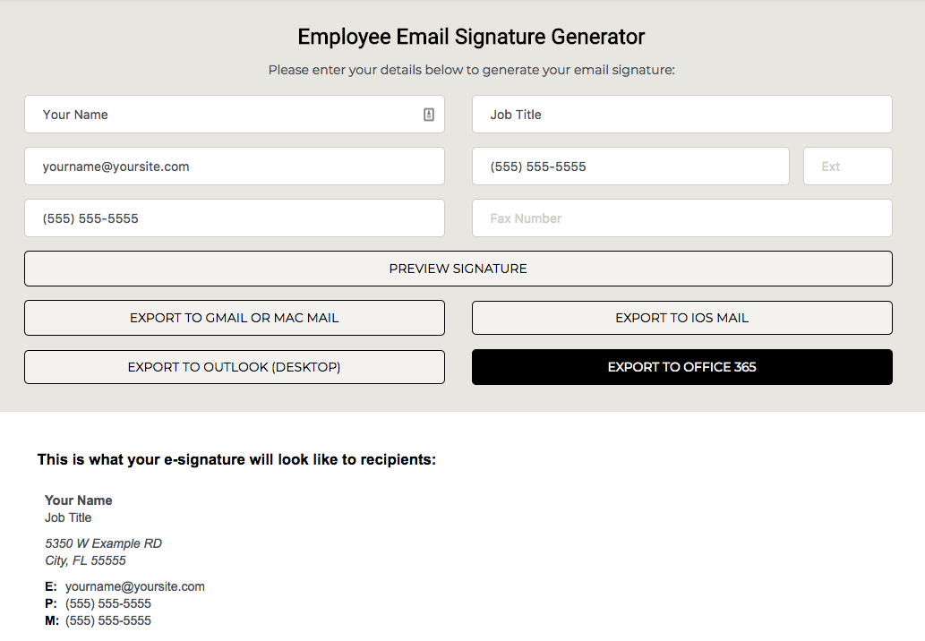
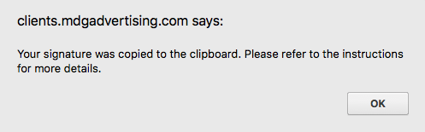
Installing On Microsoft Office 365
Please click the “Export To Office 365” button as shown to the right.
When you click the button, a dialog box like to the one below will notify you that the signature was copied to your clipboard. Click okay and continue with the instructions.

Slide 10
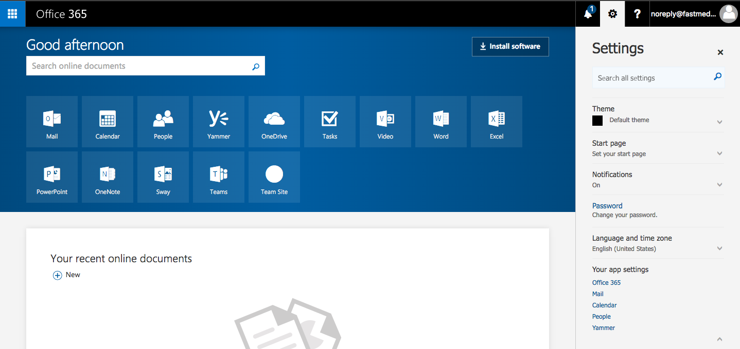
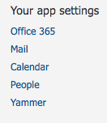
Installing on Microsoft Office 365
Next, you need to to log into your Microsoft Office 365 account at: https://login.microsoftonline.com/
Once you’ve logged in, look for the settings icon (cog wheel) located on the top right, and click on “Mail” located under “Your app settings”.

Slide 11
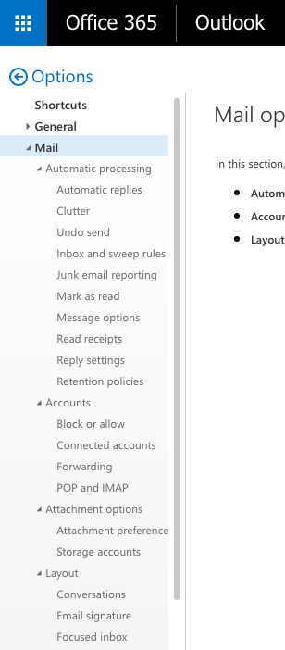
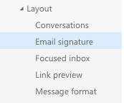
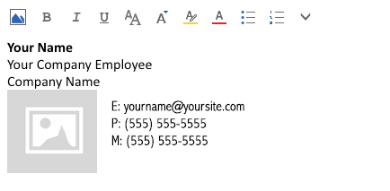
Installing on Microsoft Office 365
A sidebar will then show up on the left side of your page as shown to the left. You want to click on “Email Signature” which is located under “Layout”.
You will then need to paste the signature into the text box and make sure both of the checkboxes are checked as shown below. Proceed by clicking the save button.

Slide 12
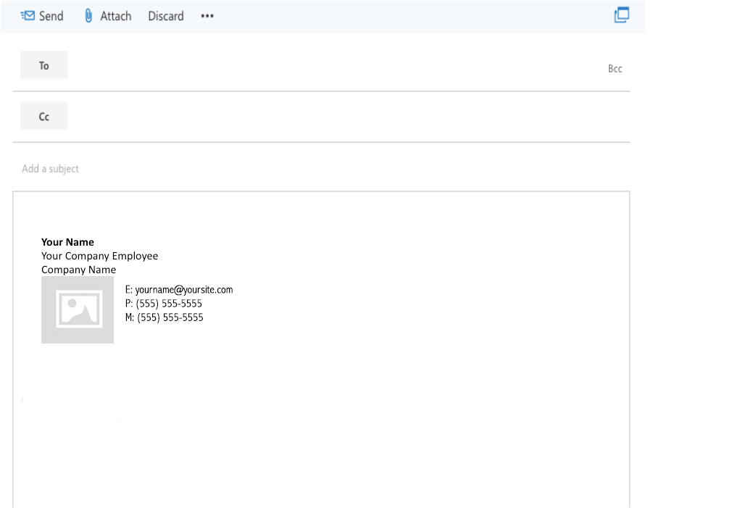
Installing on Microsoft Office 365
To test your email signature, return back to Outlook and create a new email. In the new email, your new signature should be displayed as shown in the image to the right.

Slide 13
Installing on Microsoft Outlook
Versions: Microsoft Outlook 2010, 2013, and 2016

Slide 14
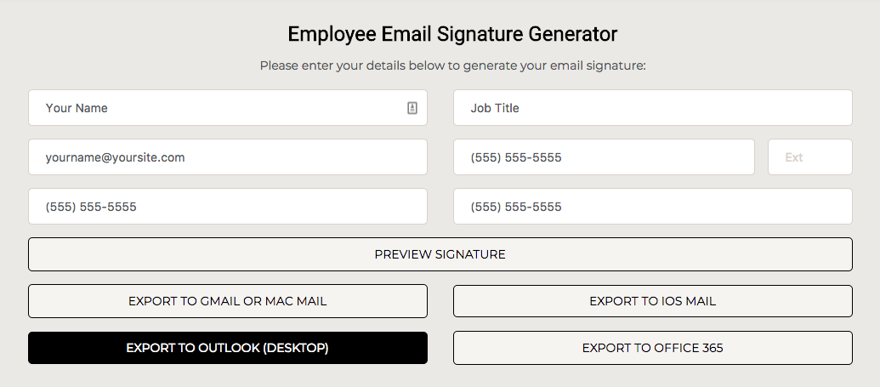
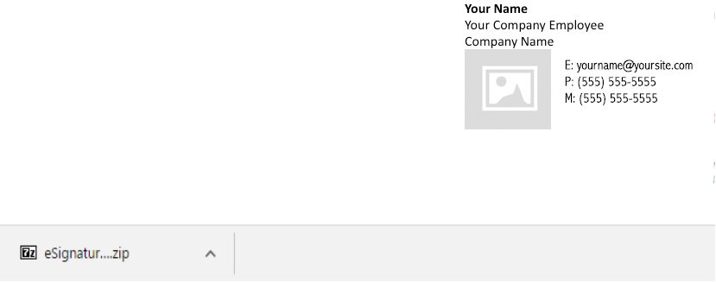
Installing On Microsoft Outlook
Please click the “Export To Outlook (Desktop)” button as shown to the right.
When you click the button, your browser will start to download a file named “*Company Name* eSignature.zip” as shown in the image below.

Slide 15
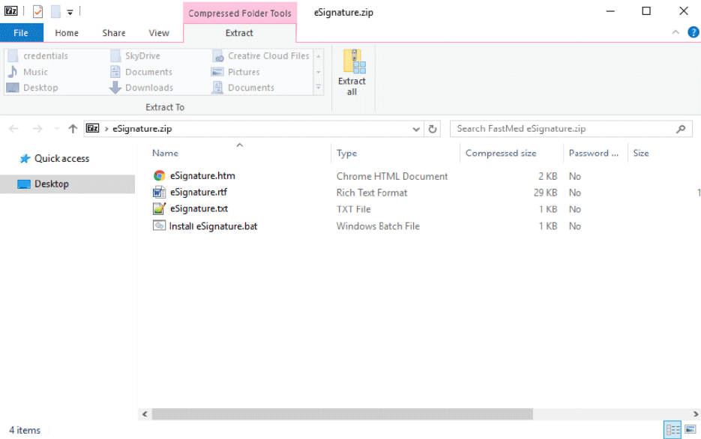
Installing On Microsoft Outlook
Double-click the .ZIP file that was downloaded.
After opening the .ZIP file , a window like the one below will open. Click the “Extract All” button circled in the image below.

Slide 16
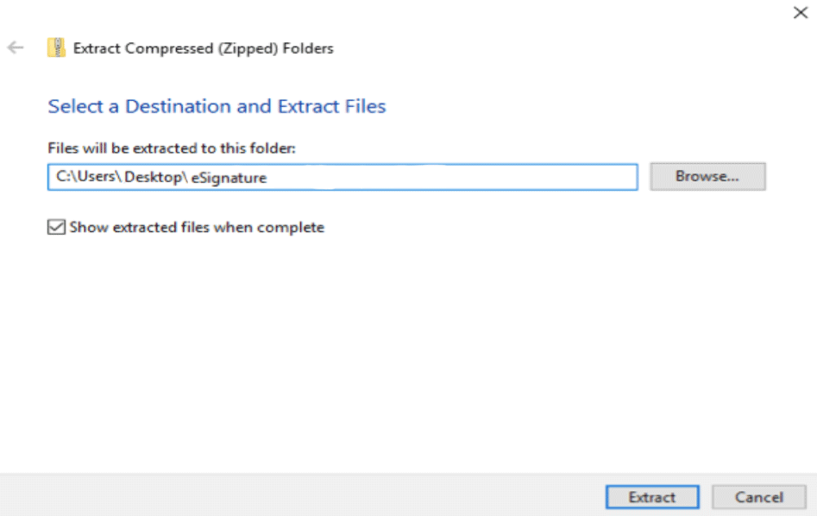
Installing On Microsoft Outlook
In the dialog that pops up, you can browse for a folder, or leave the default folder in the “Files will be extracted to this folder:” field.
Make sure “Show extracted files when complete” is checked, then click on the “Extract” button. This ensures that after extraction a window will open showing the files you just extracted, which contain the signature.

Slide 17
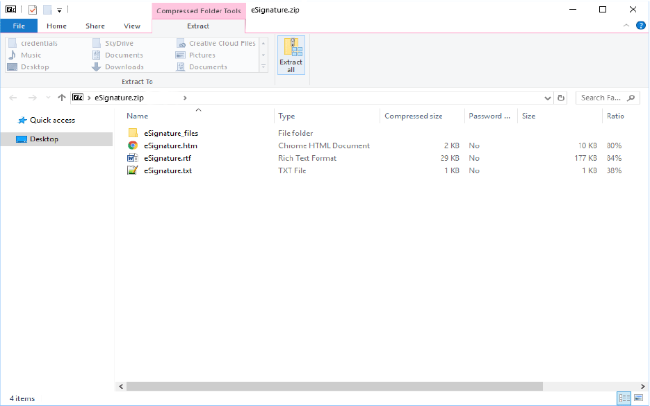
Installing On Microsoft Outlook
Keep the window that contains the newly extracted files open so that you don’t misplace them.

Slide 18
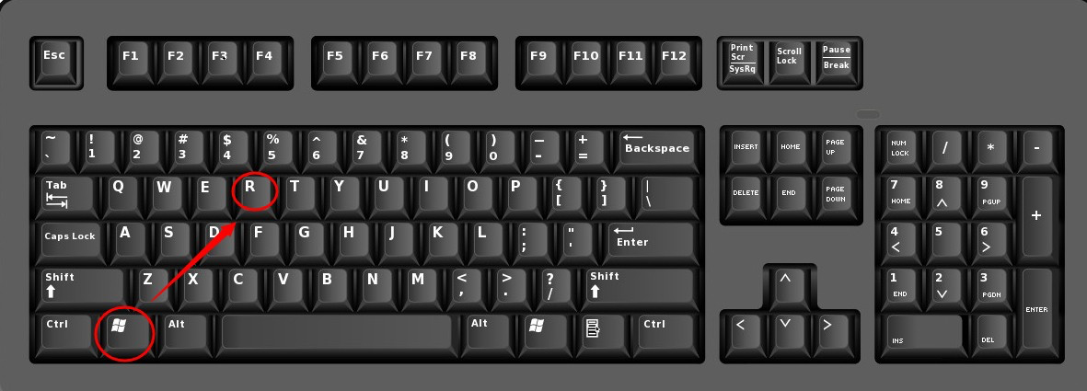
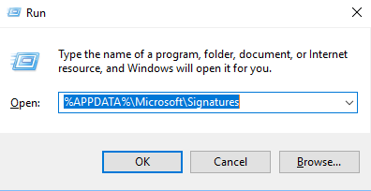
Installing On Microsoft Outlook
Press and hold the WINDOWS key and “R” key at the same time on your keyboard. This will bring up a “Run” dialog box. Next to where it says “Open”, enter the following (as shown in the image below): %APPDATA%\Microsoft\Signatures

Slide 19
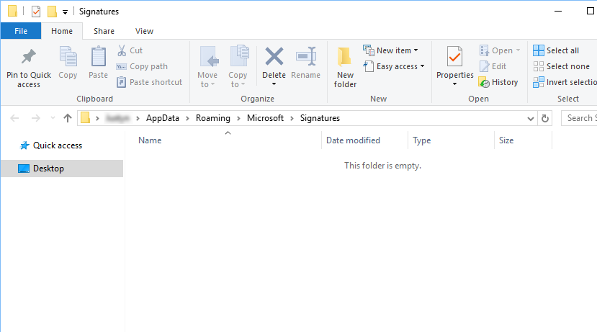
Installing On Microsoft Outlook
Another folder, named “Signatures” should now be open in a new window, as shown below. This folder stores all of your Microsoft Outlook signatures.

Slide 20
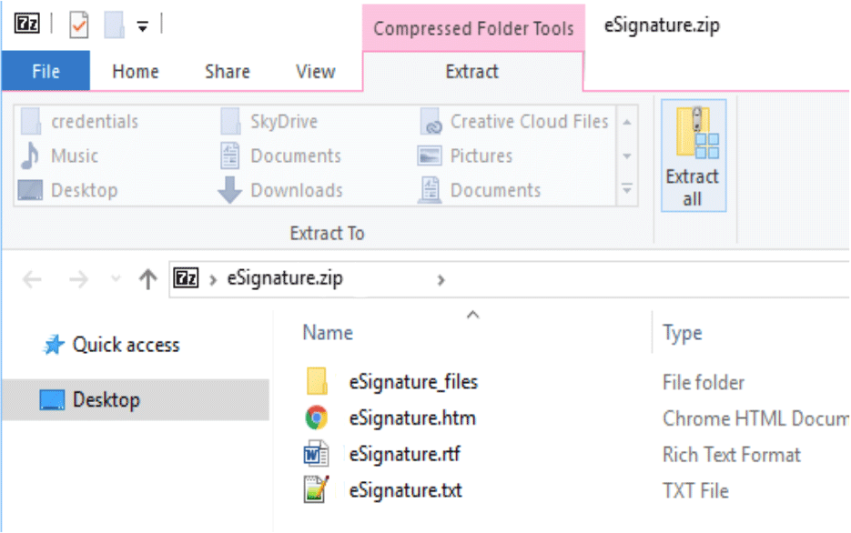
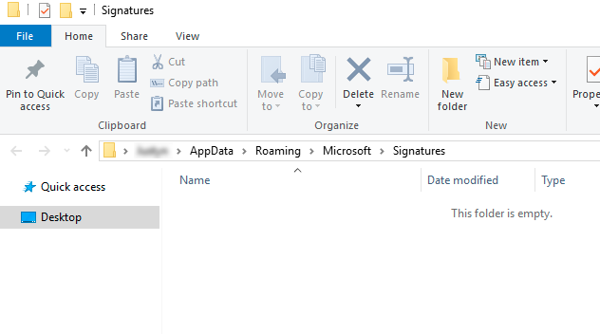
Installing On Microsoft Outlook
Next, you need to copy the extracted files in the window you kept open before (refer to page 17) to the “Signatures” window. This easiest way to do this is to highlight the 4 files and drag them into the “Signatures” window, as demonstrated below.

Slide 21
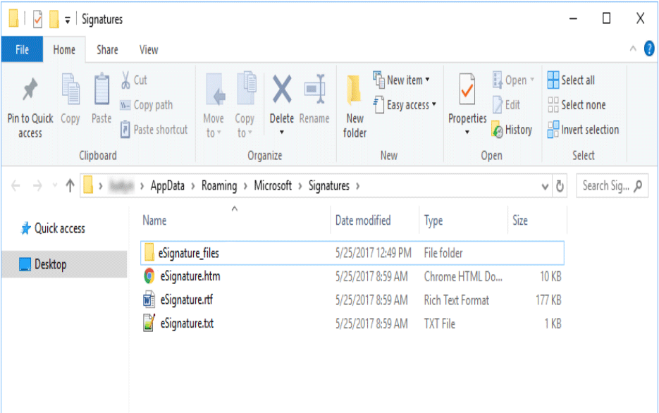
Installing On Microsoft Outlook
The “Signatures” folder should now look like the image below. You can now close this window and open up Outlook.

Slide 22
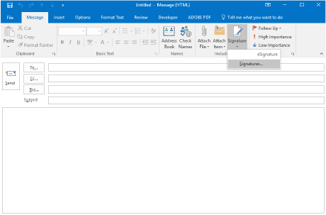
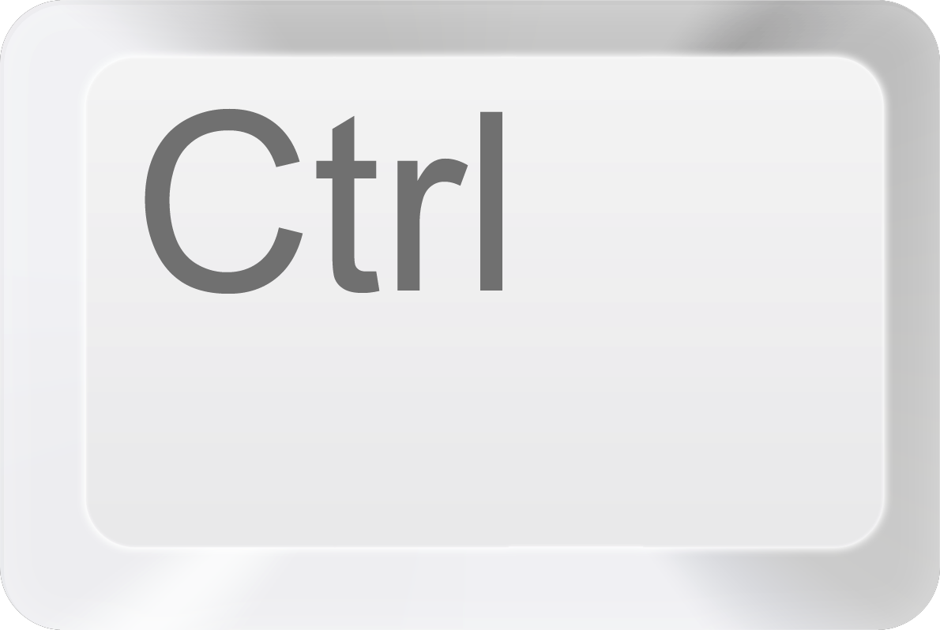
Installing On Microsoft Outlook
After opening Microsoft Outlook, compose a new message
( + N)
Make sure that the “Message” tab is selected (located between “File” and “Insert” on the blue bar at the top of the window).
Click on “Signature”, and then click on “Signatures…” in the drop-down menu as shown in the image to the left.

Slide 23
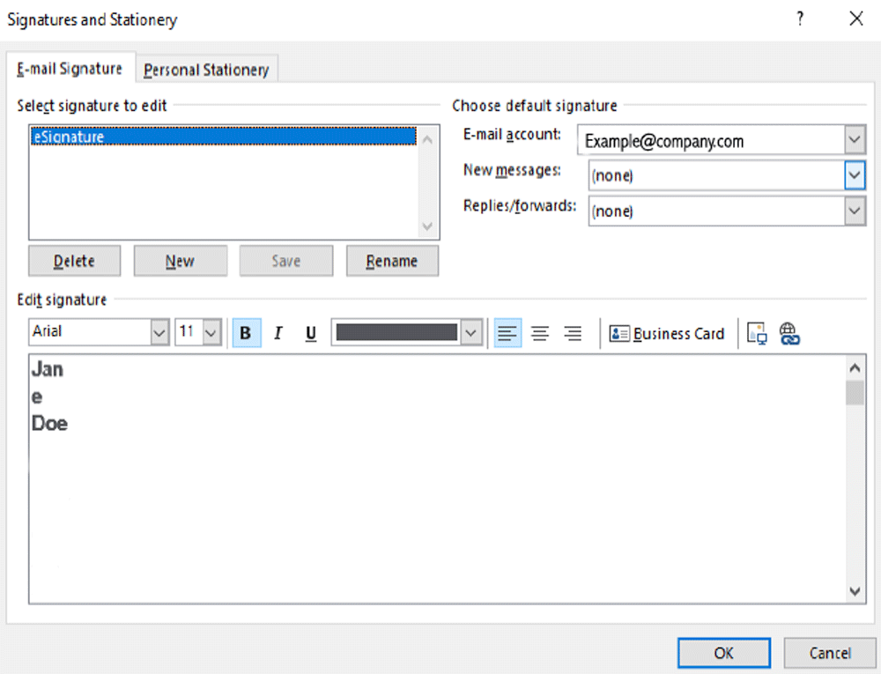
Installing On Microsoft Outlook
Under “Select signature to edit”, you should see “*Company Name* eSignature” in the list. Make sure this is highlighted in blue, like in the screenshot to the right. If not, click on “*Company Name* eSignature.”
Note: Do not worry if the signature preview in “Edit signature” does not look correct – your signature will not display like this in an email.
Additionally, please do not make modifications in the “Edit signature” window. All edits to your signature should be made directly through our Signature Generator tool.

Slide 24
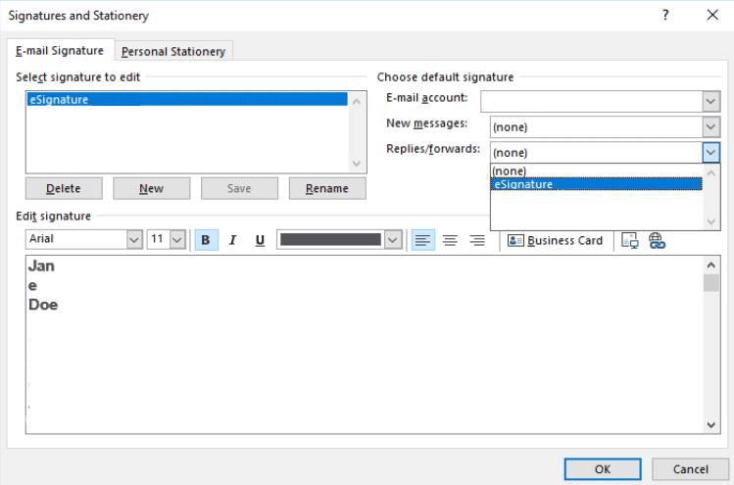
Installing On Microsoft Outlook
Click on the boxes labeled “New messages” and “Replies/forwards” and select “*Company Name* eSignature” from the drop-downs shown to the left. This ensures that any new messages or replies to messages will automatically insert your signature.
Click “OK” when done.

Slide 25
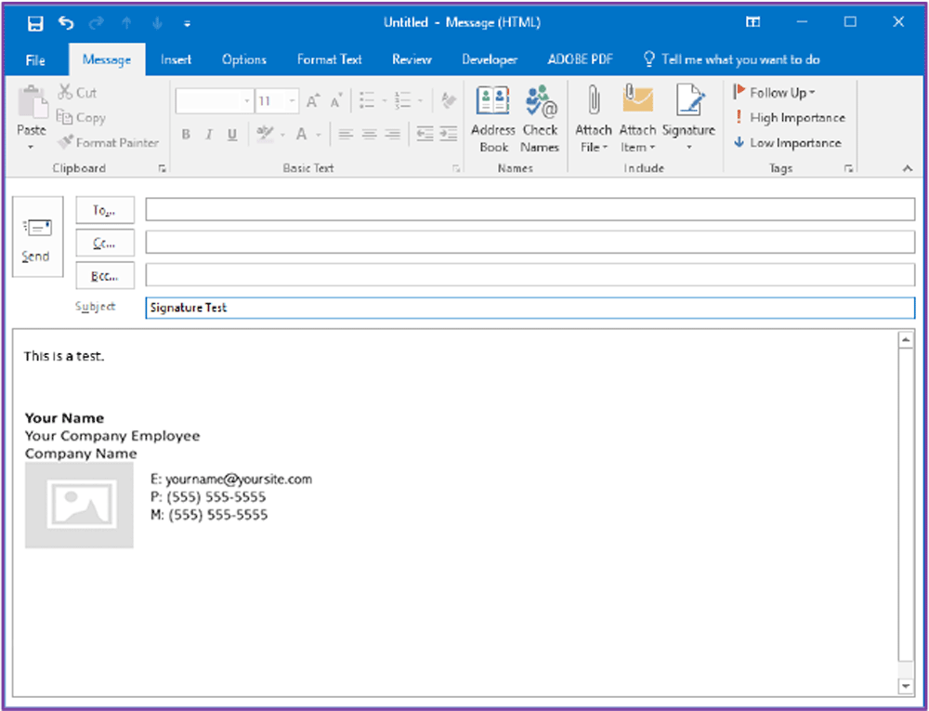
Installing On Microsoft Outlook
When you compose a new message again, you should notice your signature is now displayed in the message body as shown to the right.

Slide 26
Installing on Mac Mail

Slide 27
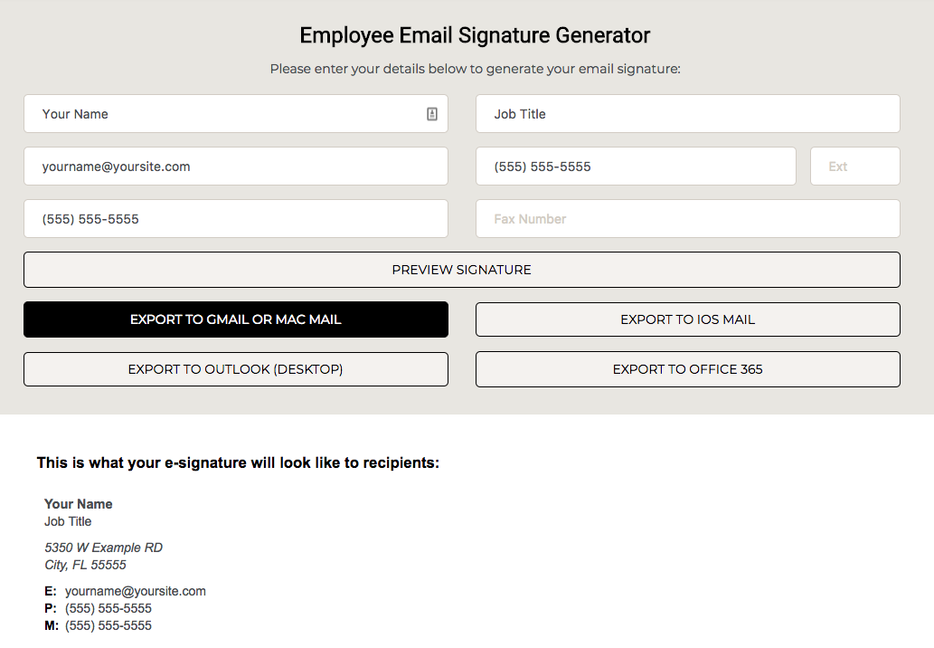

Installing On Mac Mail
Please click the “Export To Mac Mail” button as shown to the right.
When you click the button, a dialog box like to the one below will notify you that the signature was copied to your clipboard. Click okay and continue with the instructions.

Slide 28
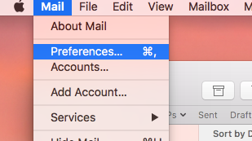
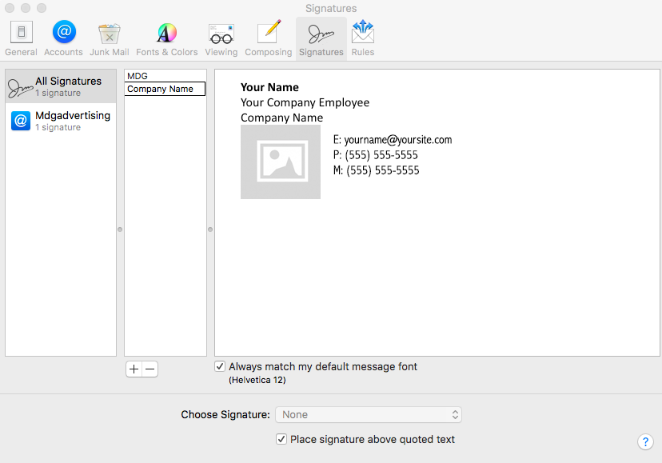
Installing On Mac Mail
After opening Mac Mail on your device, click on Mail on the top left of your screen and go to “Preferences” as shown in the image to the right.
Navigate to the “Signatures” tab and click on the plus sign as shown in the image to the left to add a new signature.
Next, type in a name for your signature (i.e., Company Name), and paste your new signature in the far right box and close the window.

Slide 29
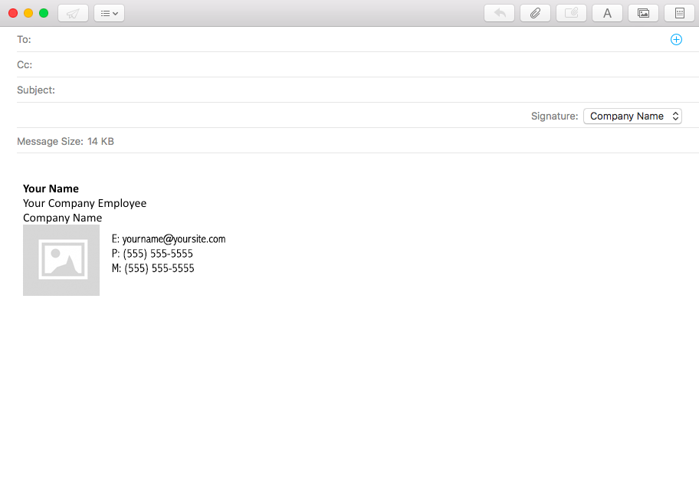
Installing On Mac Mail
To test your signature, compose a new email.
If the new signature doesn’t automatically show up in the body of the email, use the signature drop-down shown in the image to the right and select the signature you just created.
Your signature will now be displayed in all future emails.

Slide 30
Installing on iOS Mail

Slide 31
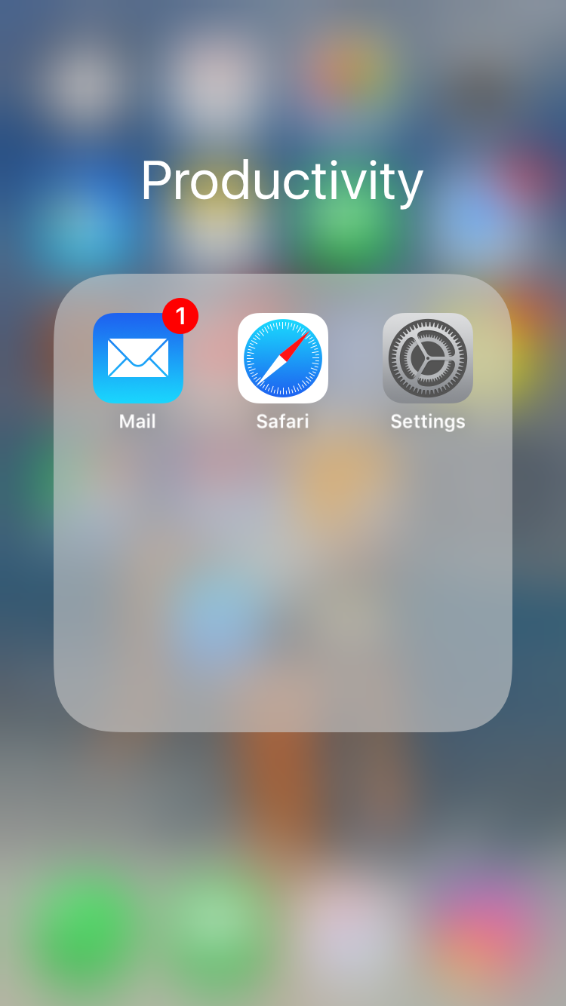
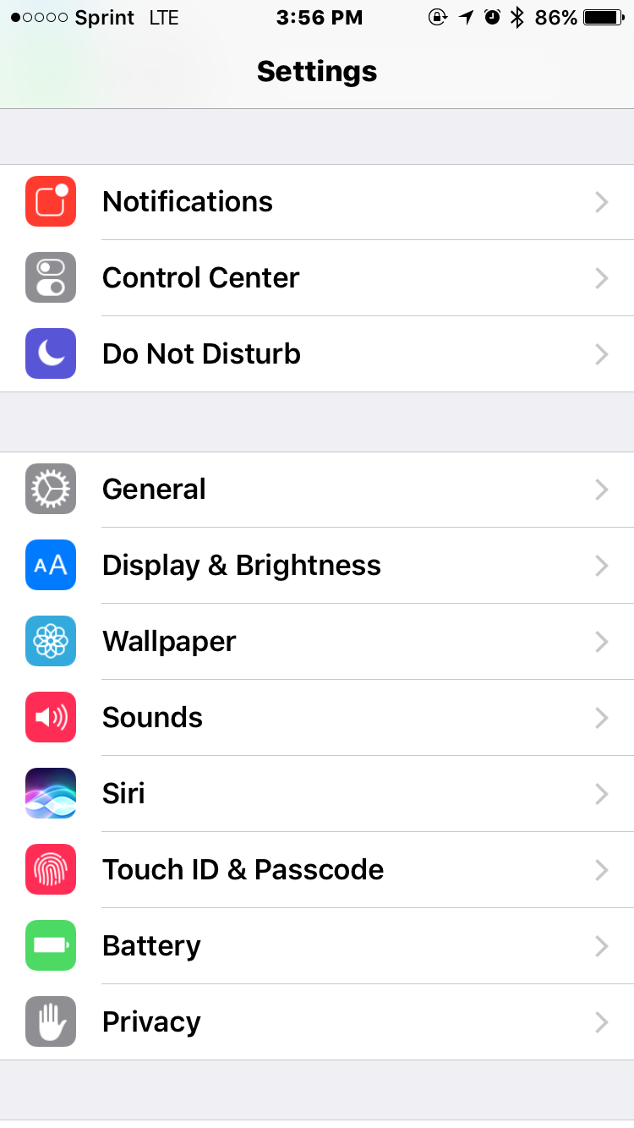
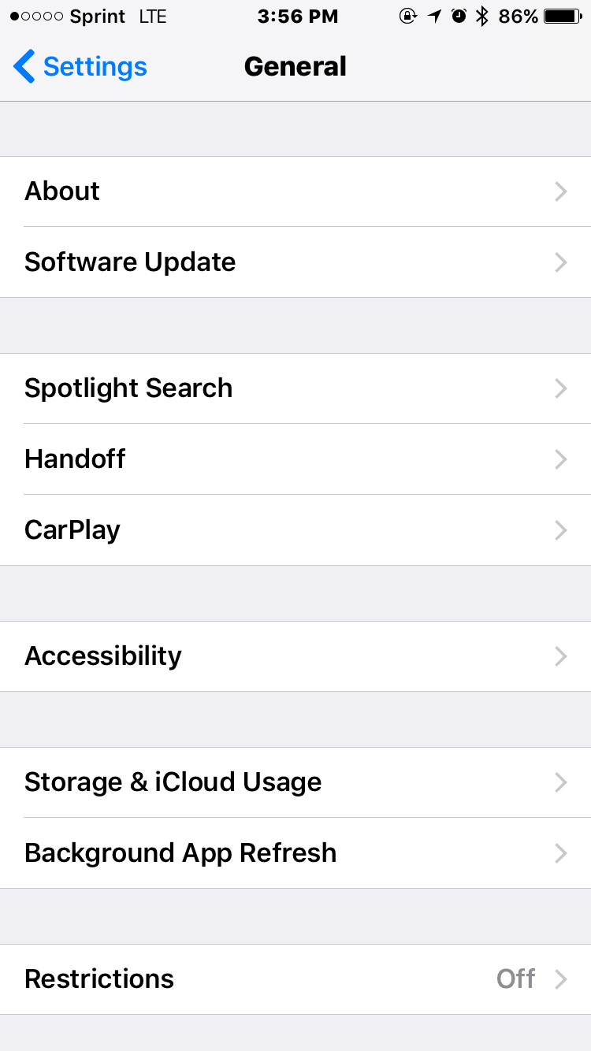
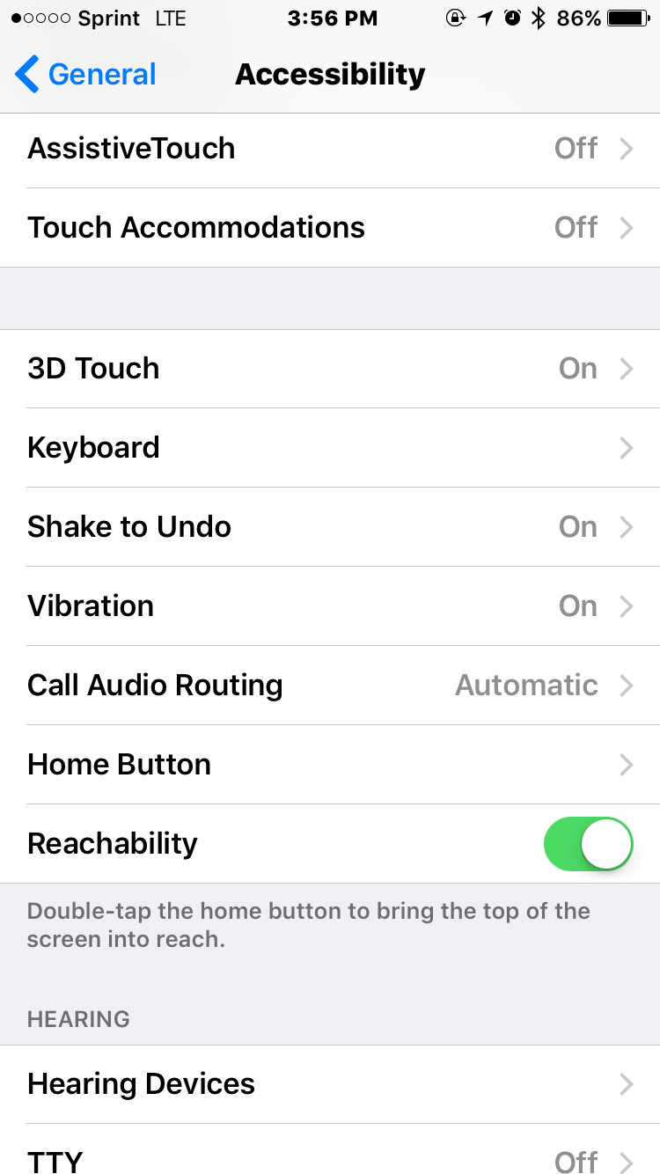
Installing On iOS Mail
First, check to make sure the “Shake to Undo” capability is on. To do this, go to your settings, scroll down to “General”, scroll down to “Accessibility”, and then scroll down to “Shake to Undo”. If it is off, you need to select it and turn it on.

Slide 32
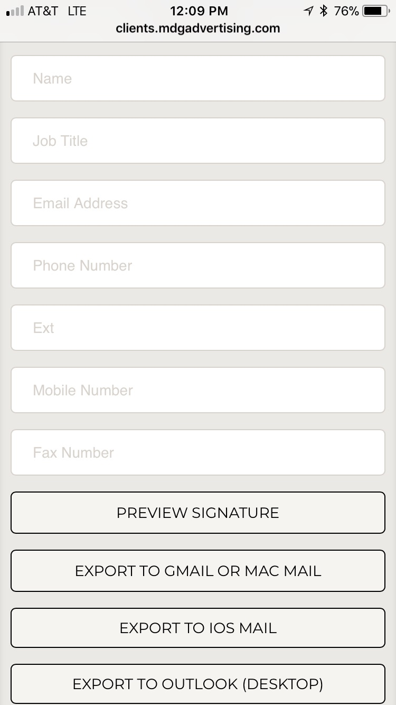
Installing On iOS Mail
If you are using iOS Mail, first you need to go to the signature generator tool website on your device in a web browser as shown to the right.
Add your information as shown and click “Preview Signature” to make sure you added your information correctly.

Slide 33
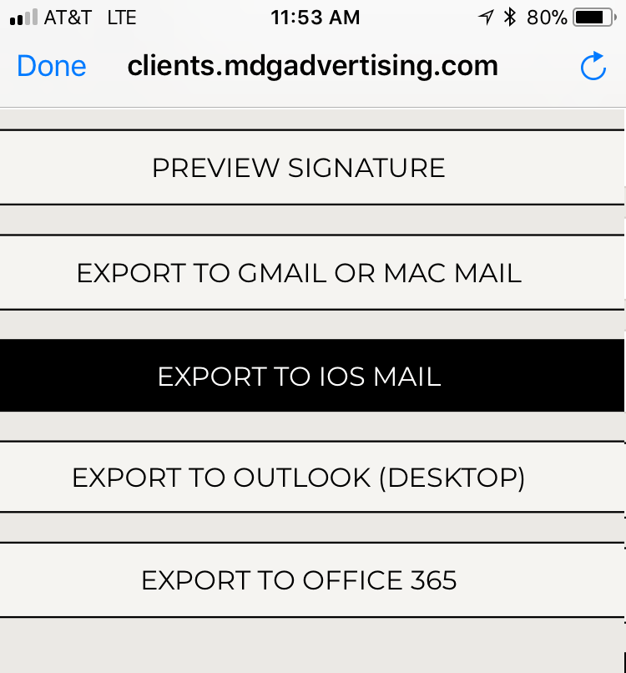
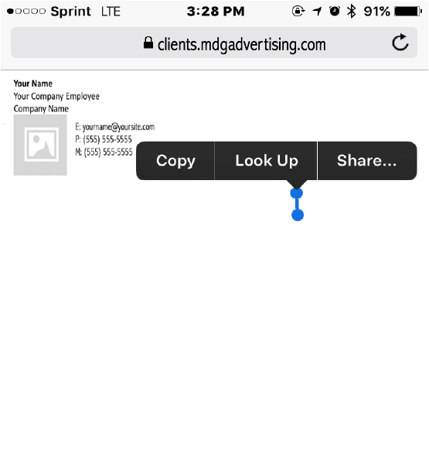
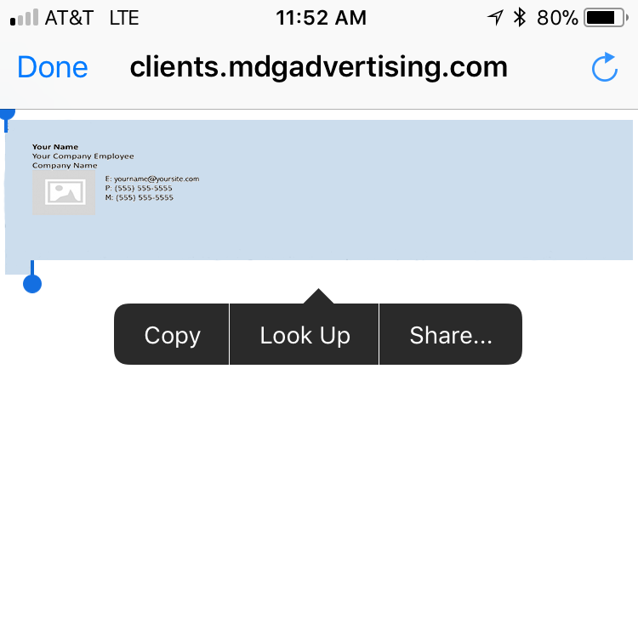

Installing On iOS Mail
Next, click on “Export to iOS Mail”, which will open up a new tab in your web browser that contains the new signature. You need to long press (touch and hold) the screen with your finger at the bottom of the signature until it looks like the 2nd image below. Then, drag the blue line until it covers the entire signature, as show in the 3rd image. Finally, tap “Copy”.

Slide 34
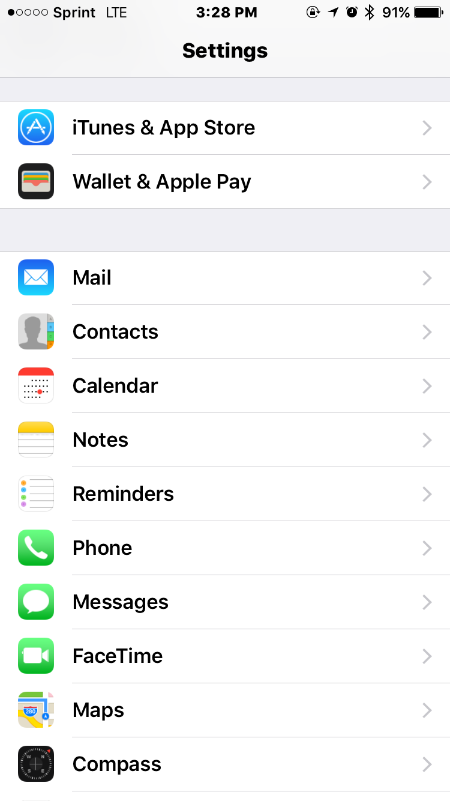
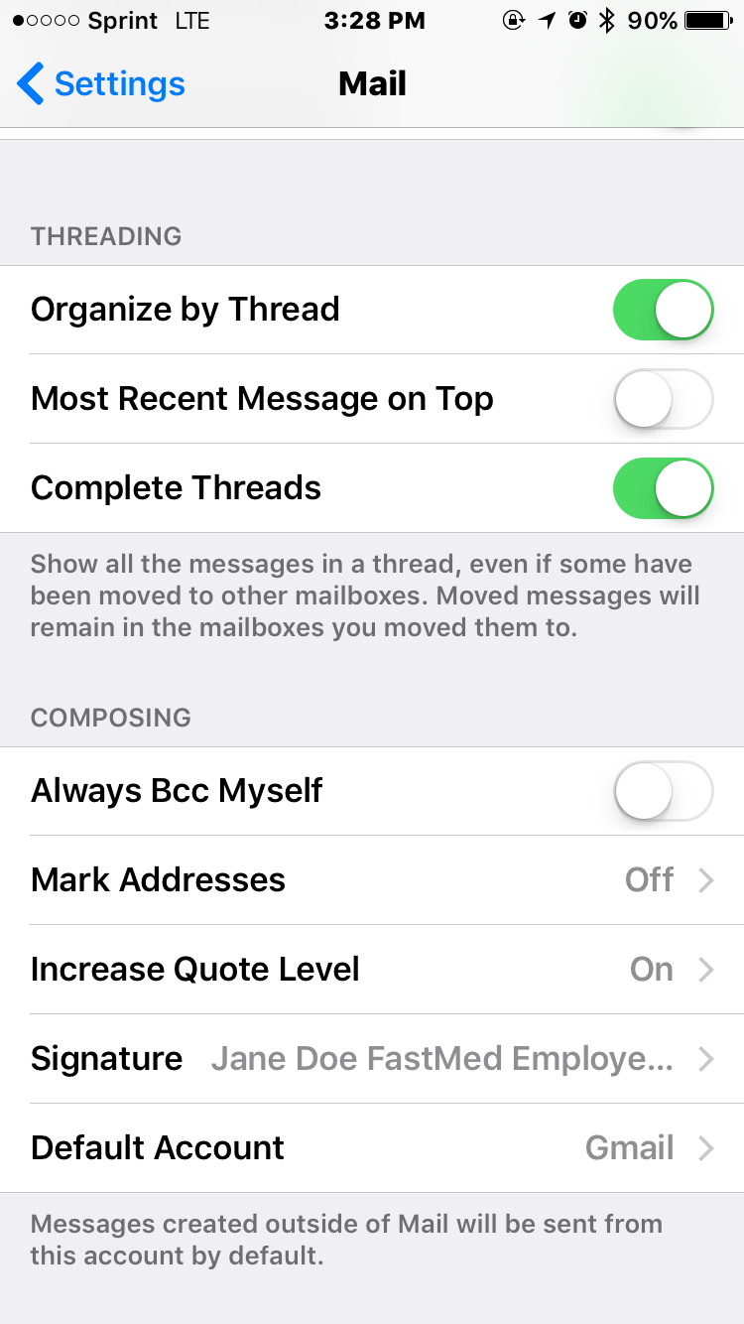
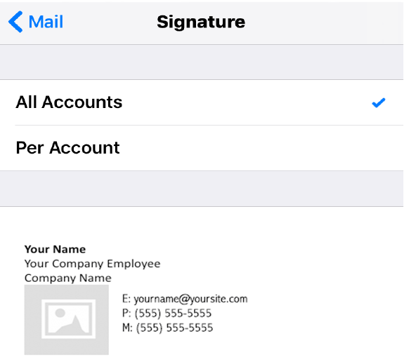
Installing On iOS Mail
Now, you need to go to your device’s settings and navigate to “Mail”. Inside the Mail settings, scroll down to “Signature”.
Inside the signature settings, you can select an email account to add the signature to, or apply it to all of them, depending on your needs. Long press (touch and hold) your finger down in the empty box and select “Paste”.

Slide 35
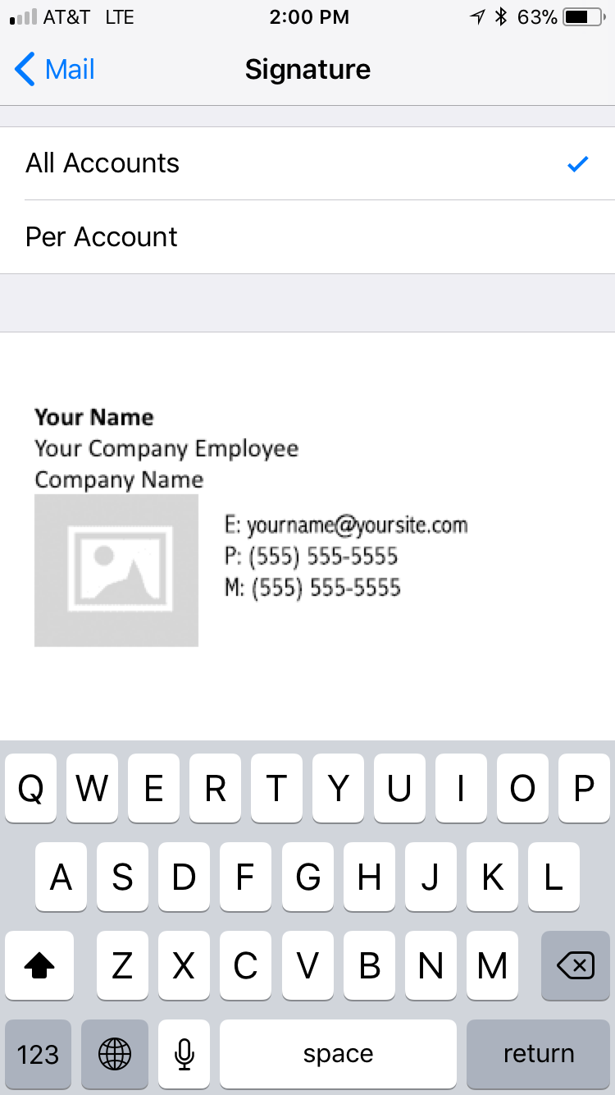
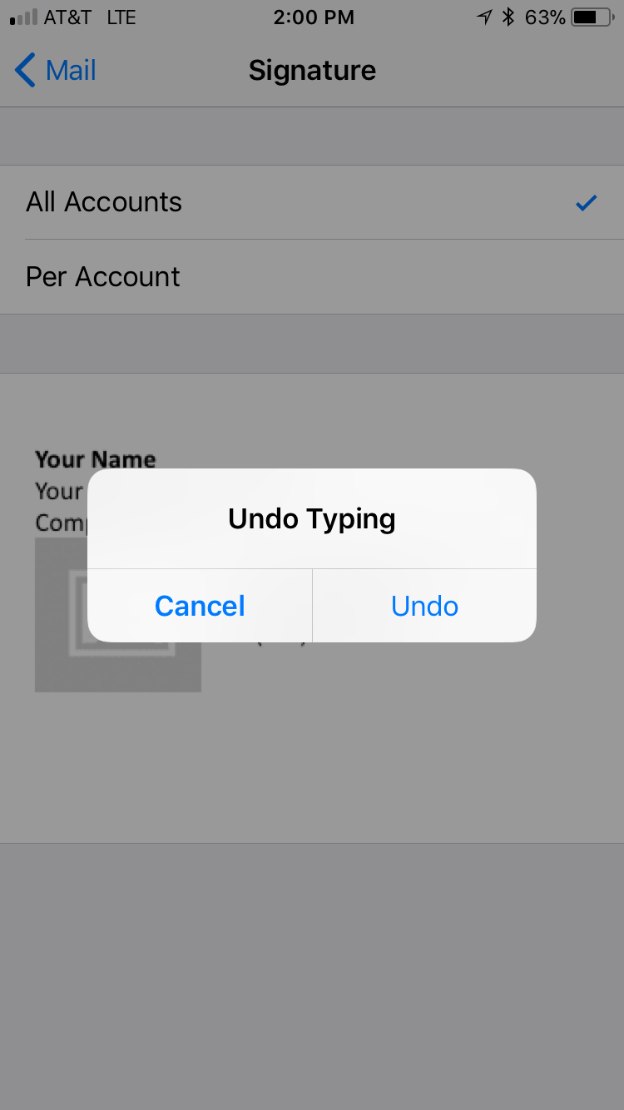
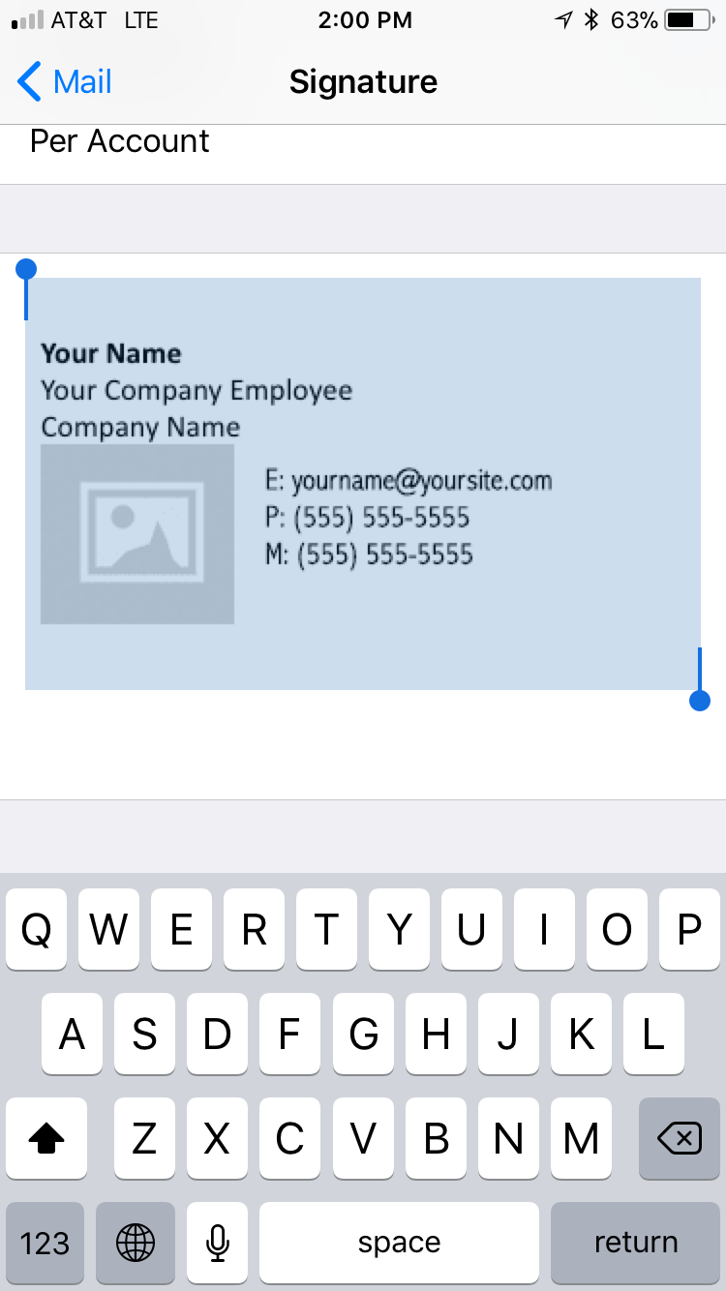
Installing On iOS Mail
After you paste the signature in the empty box, you might notice that some of the colors and text fonts were changed, compared to the preview. To fix this, you need to slightly shake your phone until a box pops up on your screen that says “Undo Change Attributes,” as shown below. When this box pops up, you need to tap “Undo”. You should notice the colors and fonts are fixed.

Slide 36
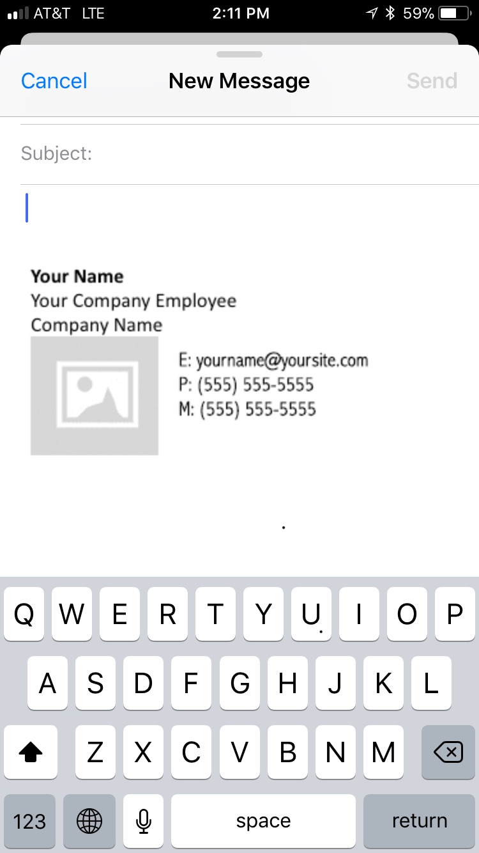
Installing On iOS Mail
Finally, when you return to your email app and compose a new message, your new signature is now the bottom of your message.

Slide 37
Installing On Gmail

Slide 38
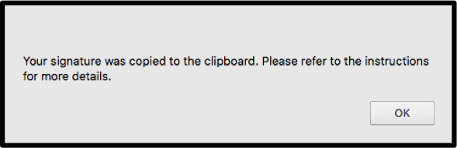
Installing On Gmail
Please click the “Export To Gmail or Mac Mail” button as shown to the right.
When you click the button, a dialog box like to the one below will notify you that the signature was copied to your clipboard. Click okay and continue with the instructions.

Slide 39
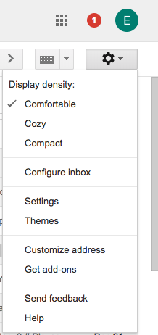
Installing On Gmail
In the to right, click the Settings
tab in the settings gear drop
down menu.

Slide 40
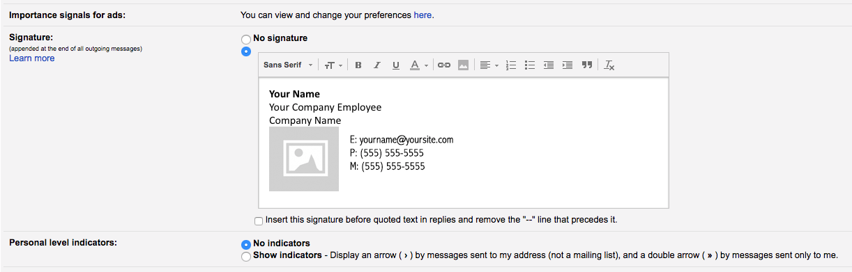
Installing On Gmail
In the “Signature” section, add your signature text in the box. If you want, you can format your message by adding an image or changing the text style.

Slide 41
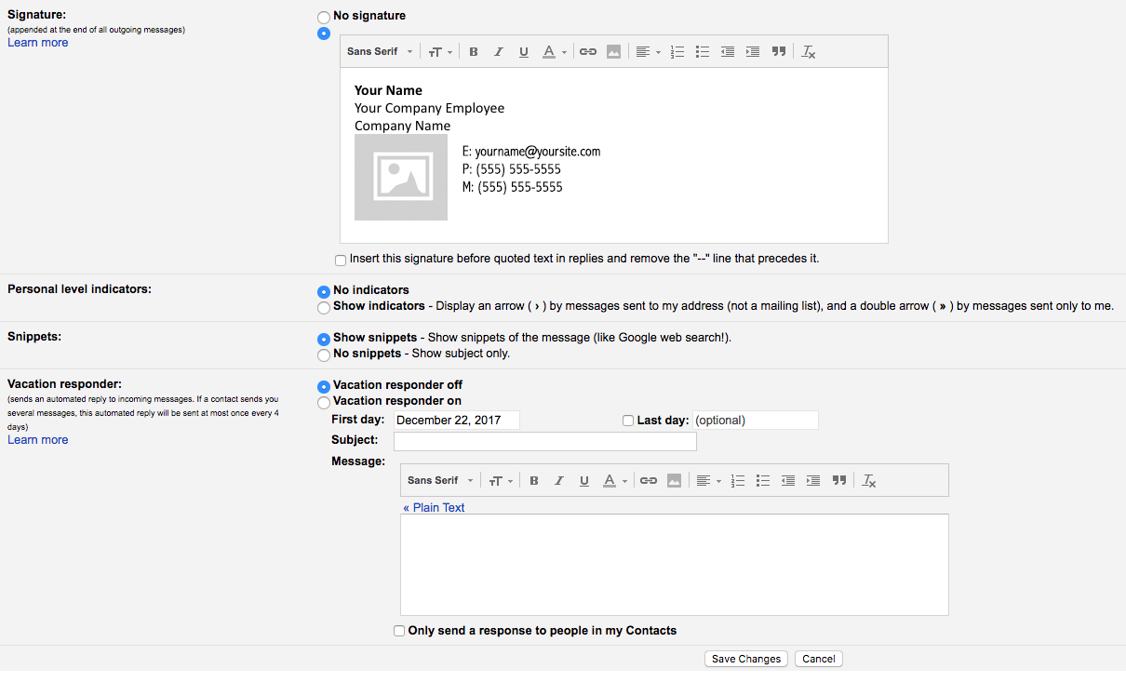
Installing On Gmail
At the bottom of the page, Click “Save Changes” to commit the changes.

Slide 42
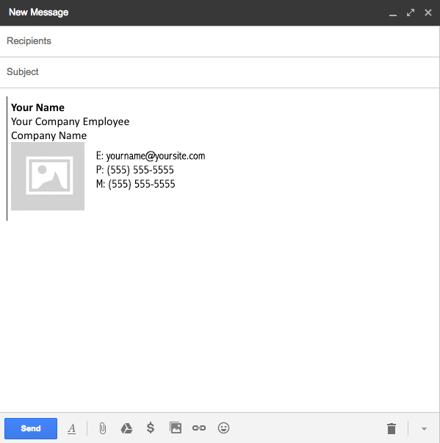
Installing On Gmail
When complete, verify that your
signature appears in the email
body text area.

Slide 43
Installing on Android Mail Apps

Slide 44
Installing On Android Mail Apps
Unfortunately, most Android mail apps (including Gmail) do not support HTML email signatures. Please refer to documentation from your Android mail app to see if it supports HTML signatures and instructions on installing HTML signatures.

